Slide 1
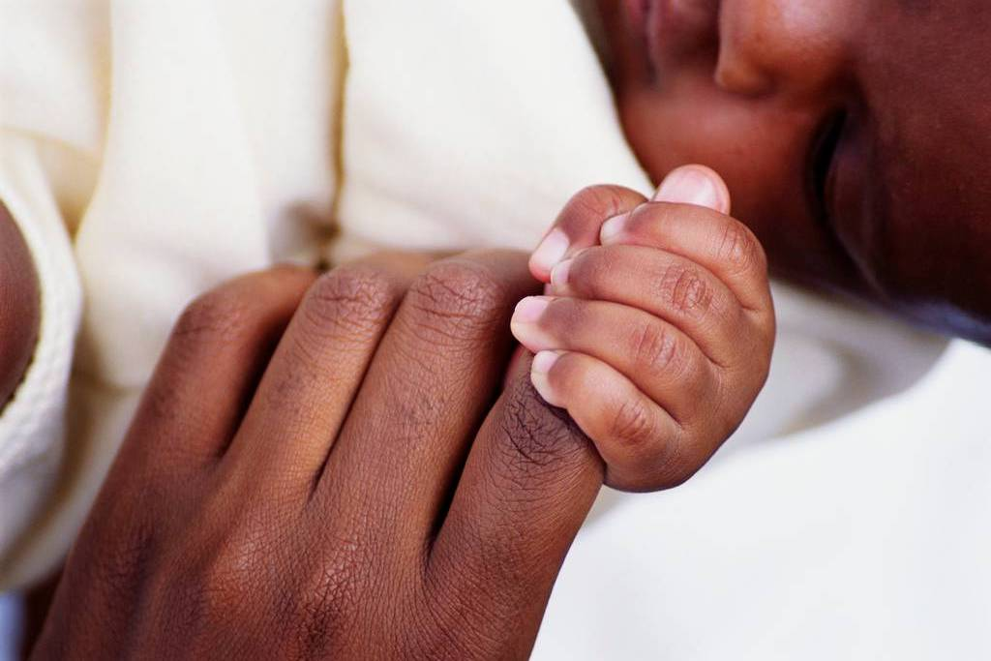


MTN-016
Evaluation of Potential Major Malformations

Slide 2
Major Malformations (V 1.0)
Defined as structural abnormalities that meet the following criteria:
  Have surgical, medical, or cosmetic importance
  Ascertained up to one year of age
NOT considered as major malformations:
  All birth marks
  All minor physical features
  Deformities that represent normal response of fetal tissue to mechanical forces
Notes:
2
ADDED NOTE RE 1.0, DEF CHANGES IN 2.0

Slide 3
Exclusions to major malformations in Version 2.0
Minor physical features
Deformities that represent normal response of fetal tissue to mechanical forces
  atypical body part growth and/or appearance due to fetal position and/or pressure of surrounding maternal tissue(s)
  e.g., molding of skull
Physical features at birth normally present <37 weeks
Findings on prenatal ultrasonography but not on physical examination
Genetic disorders

Slide 4
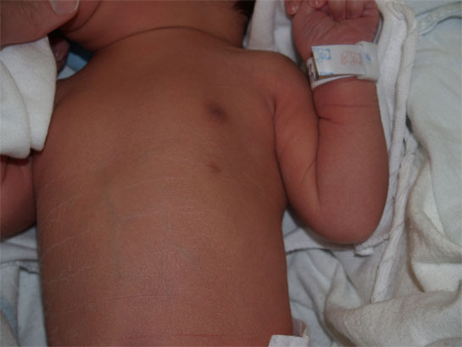
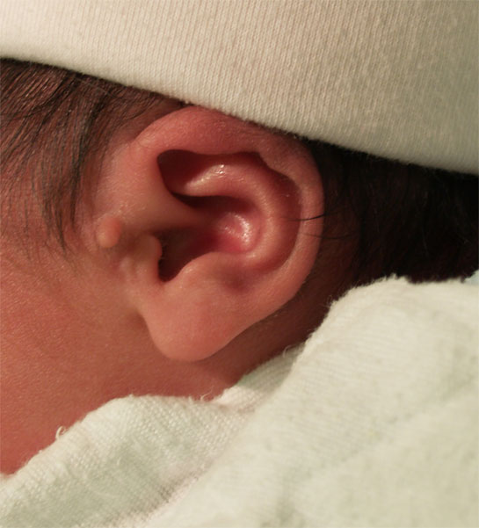
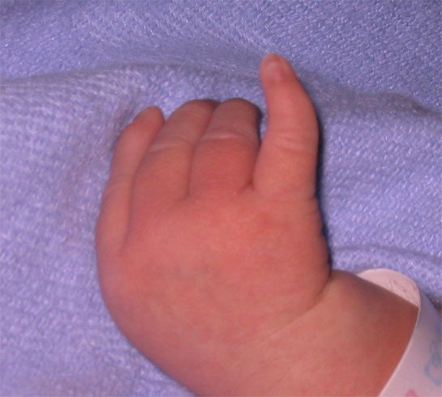
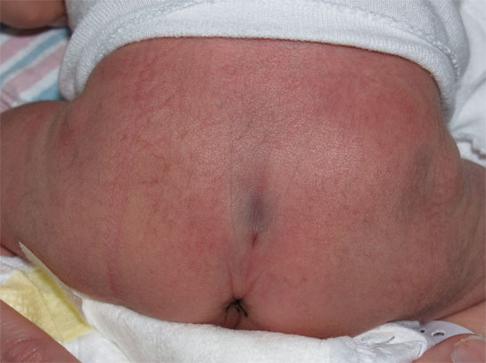
Minor Malformations
Notes:
4
For the purposes of MTN-016, the presence of a single minor anomaly will not be considered a major malformation but the presence of two or more may raise the index of suspicion
. These “physical differences” do not have clinical significance. Examples of minor anomalies include curvature of the 5th finger (clinodactyly), a third nipple, tiny indentations of the skin near the ears (preauricular pits), shortness of the 4th metacarpal or metatarsal bones, or dimples over the lower spine (sacral dimples). A simple dimple is one that is located within 2.5 cm of the anus, has a base that can be visualized and is not associated with other abnormalities on exam. The dimple in this photo is the tiny dark brown shadow below the slate grey patch at the superior end of the gluteal crease.
However, it is important to recognize that they may be associated with major occult malformations or genetic syndromes. For the purposes of MTN-016, the presence of a single minor anomaly will not be considered a major malformation but the presence of two or more may raise the index of suspicion.

Slide 5
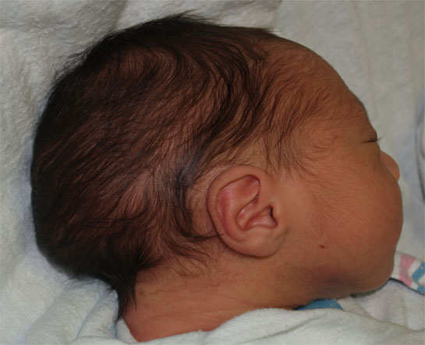
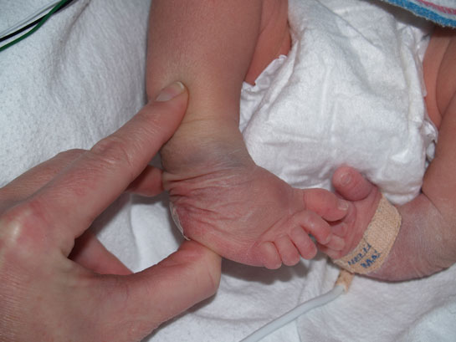
Deformities
Notes:
Deformities that represent the normal response of fetal tissue to mechanical forces (i.e., atypical body part growth and/or appearance attributable to fetal position and/or pressure of surrounding maternal tissue(s). For example, molding of the skull, also known as positional plagiocephaly, would not be considered a major malformation.

Slide 6
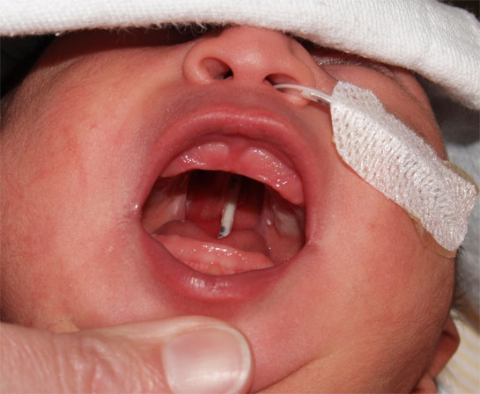
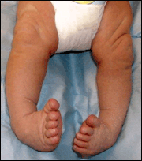
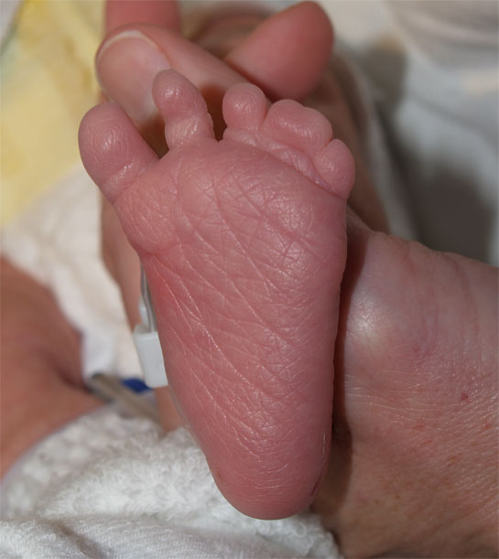
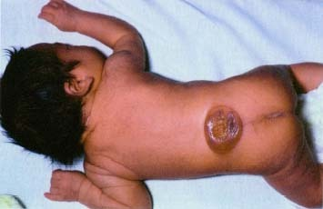
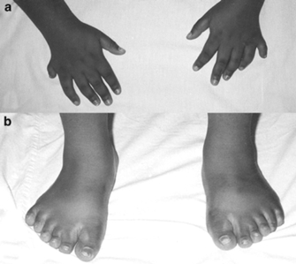
Major Malformations
Notes:
Cleft Palate
Talipes (clubfoot) - distinguish that may be due to lack of fluid-could be deformity rather than malformation
Syndactyly
Spina Bifida
Polydactyly

Slide 7
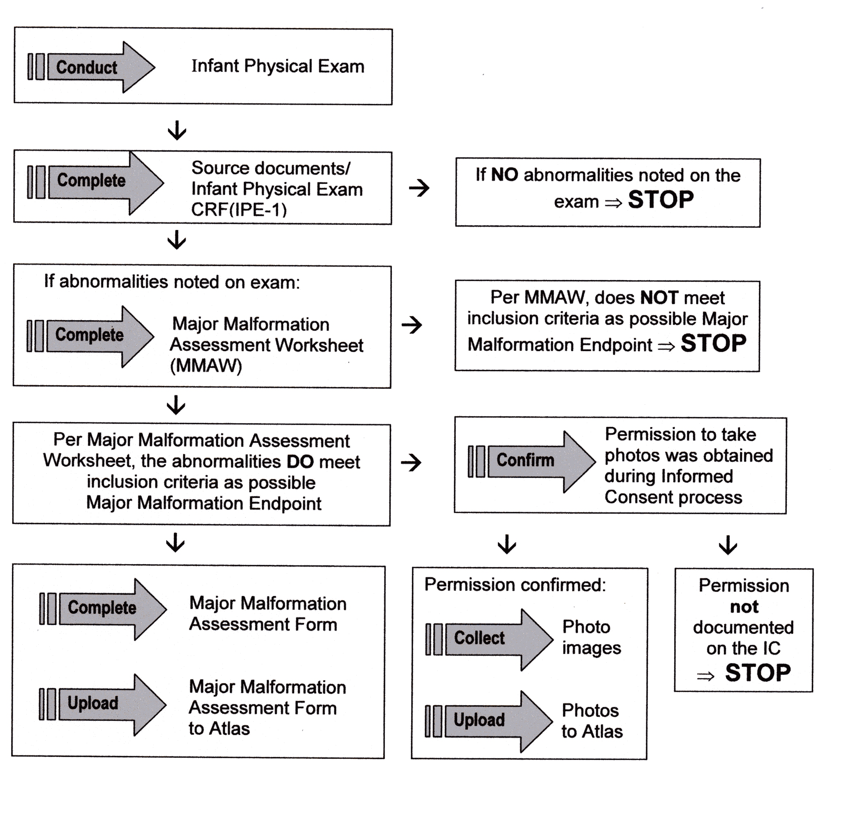
Documentation of Anomalies
Notes:
7

Slide 8
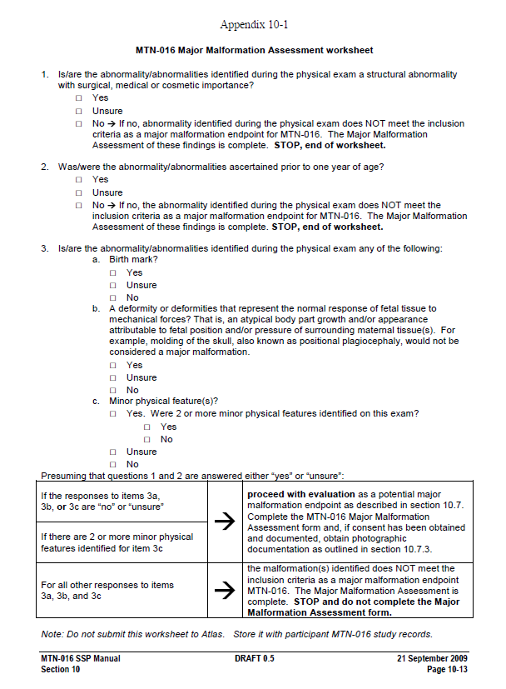
MMA Worksheet
Used to determine if abnormality noted during the PE meet inclusion criteria for possible Major Malformation Endpoint.

Slide 9
MMA Form
Completed when abnormality noted on PE may be eligible as a major malformation endpoint.
Use MMA worksheet to determine if MMA form should be submitted.
Done with or without photo documentation.

Slide 10
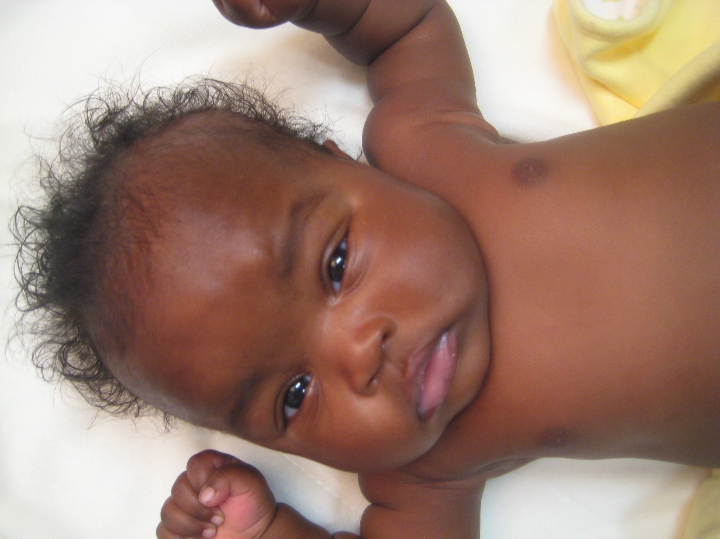
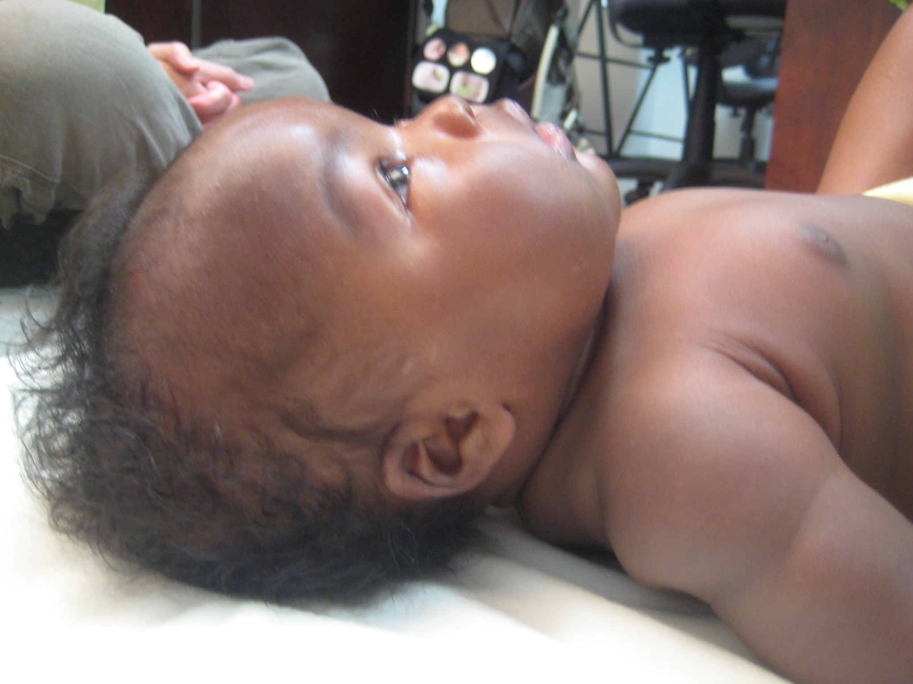
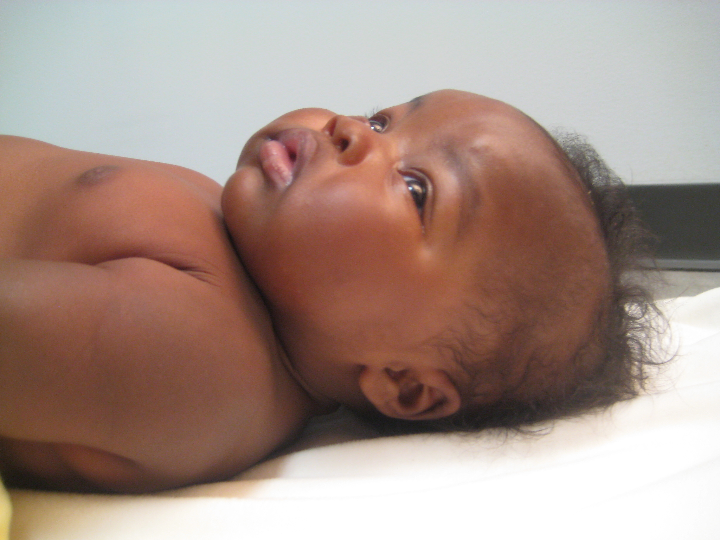
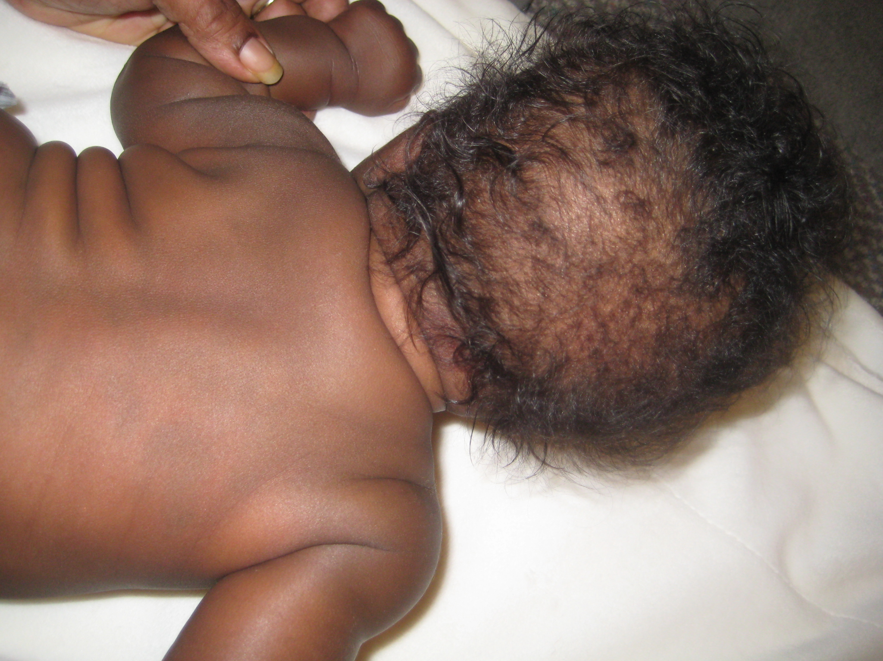
Photographing Infant
Head/Neck/Torso – 4 Views
Notes:
Note that – for the purposes of evaluating any anomaly – a full photographic survey of the infant is requested – not simply one or two photos of the anomaly.
We have prepared a flip chart that will provide examples of the views that are requested. (Show the chart and pass it around.)
4 Views: Front, Back, Left, Right

Slide 11
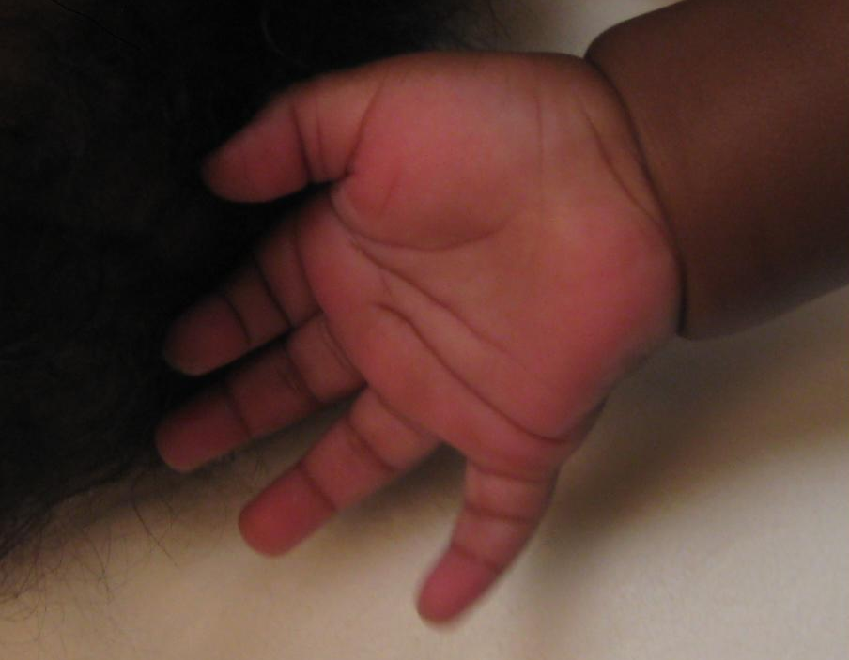
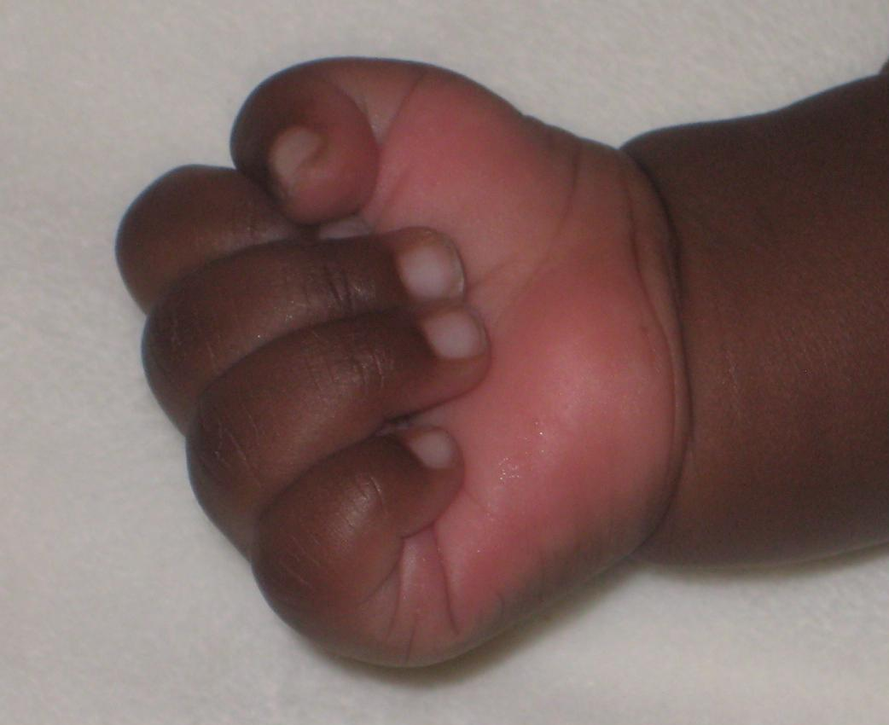
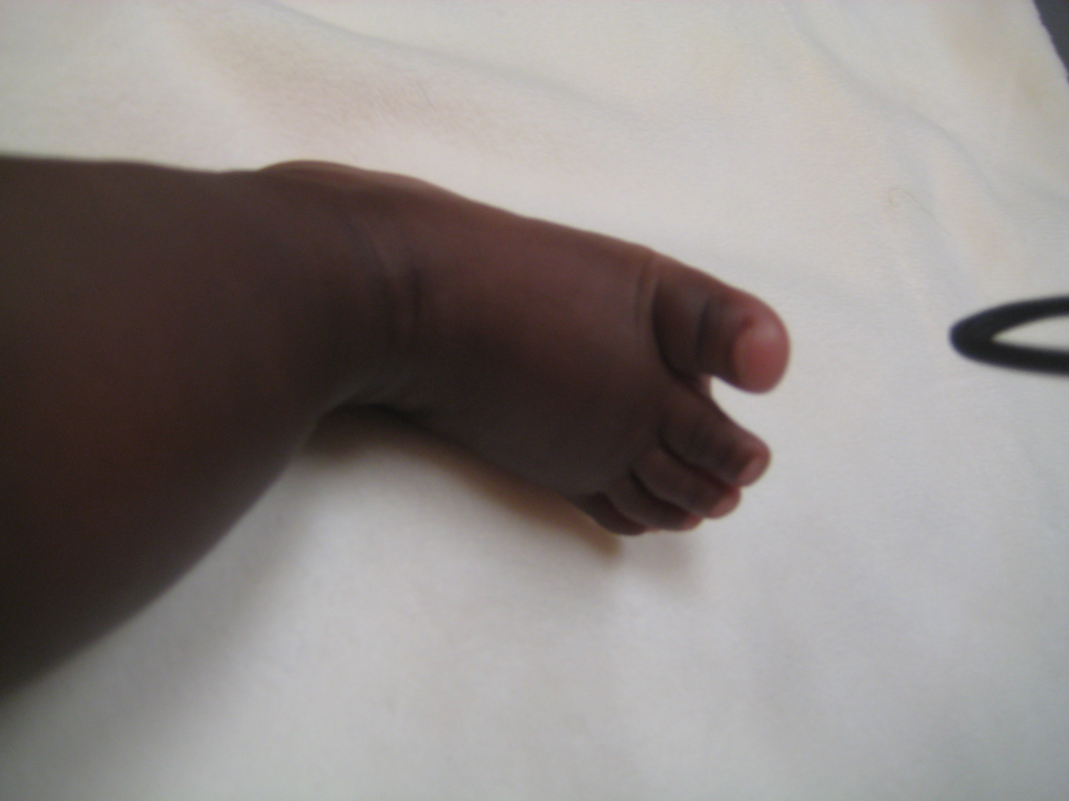
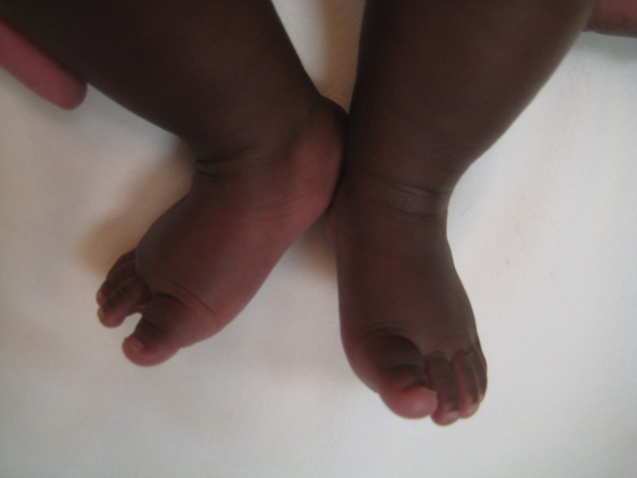
Photographing Infant
Palm view of hands
Top view of hands
Top view of feet
Notes:
Note:
- If abnormality is noted on the PE and consent has been obtained for photos, a complete photo survey of the infant in addition to photos of the abnormally is requested.
- Area of interest should take up ~75% of screen, or as close as possible without being out of focus.
- Both hands can be photographed together, but it may be easier to do individually. Same for feet.

Slide 12
Tips for taking the photos
Mother should be present
Keep the baby warm
Easiest when baby is fed and calm
Don’t force any positions
Extra lighting may be needed; do use a flash if available
Solid background is preferred
Write the infant PTID on a piece of paper and position near the infant in the photo
Take extra views and select the best for uploading!
Notes:
Keep example photos with the camera along with copied section of SSP (how to upload, etc), and site SOP

Slide 13
Uploading to ATLAS
SiteName_301123491_22OCT2009_facenecktorso_1
Notes:
Reference SSP Section 10 page 10 for table with site and anatomical location naming conventions.
If a second image was taken on same day of same location, the file will be named sequentially (“_2”), and so on.

Slide 14
Uploading to ATLAS
Do not upload only photos of suspected abnormality – include all views required by the protocol
Sites should schedule a practice submission to confirm that:
  On-site camera is adequate
  Bandwidth is sufficient
  Uploading is possible from your clinic computer

Slide 15
Major Malformation Scenario
Alfonso is a 3 day old with a very large discoloration on his forehead.
Notes:
Is this a birthmark? If so, this would not qualify as a major malformation.

Slide 16
Major Malformation Scenario
Is this a simple birthmark?
  If yes, not a major malformation.
  If this is more than a birthmark, refer to pediatrician
  Complete the MMA Worksheet to confirm, and then…
  Complete the MM Assessment Form
  Review IC to confirm permission granted to photograph infant.
  Take photographs per site SOPs and upload to ATLAS.
Notes:
Is this a birthmark? If so, this would not qualify as a major malformation.

Slide 17
Major Malformation Scenario
Thomas is born with albinism.
Is this a major malformation?

Slide 18
Scenario Answer
Albinism is to be documented as a major malformation for this protocol.

